Slide 1
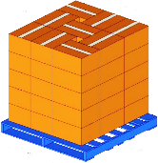
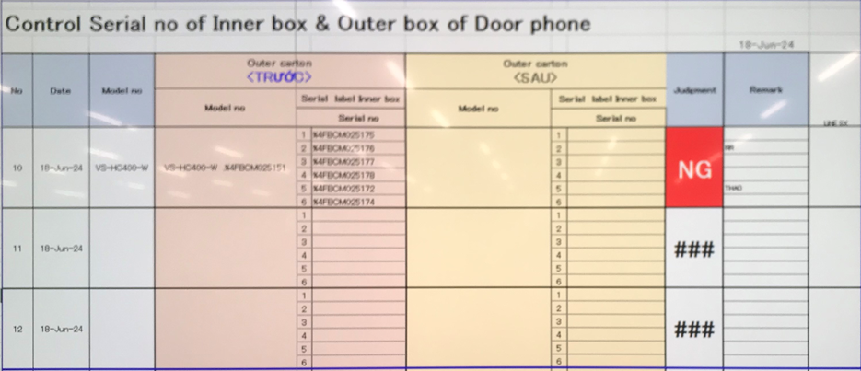
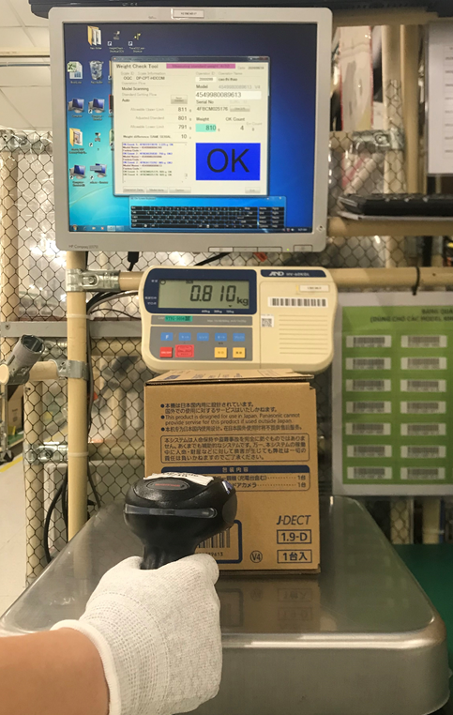
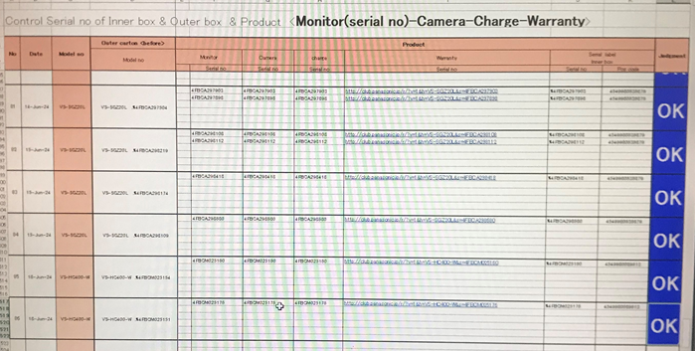
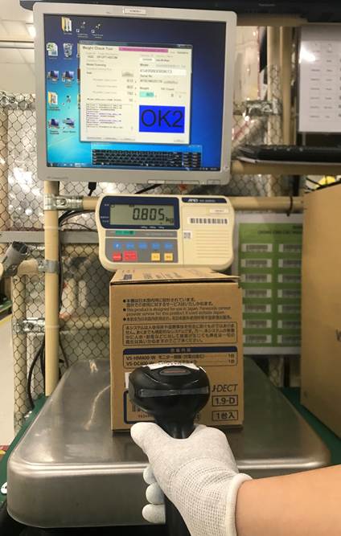
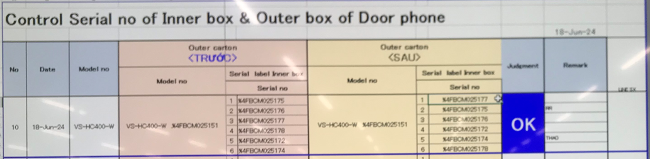
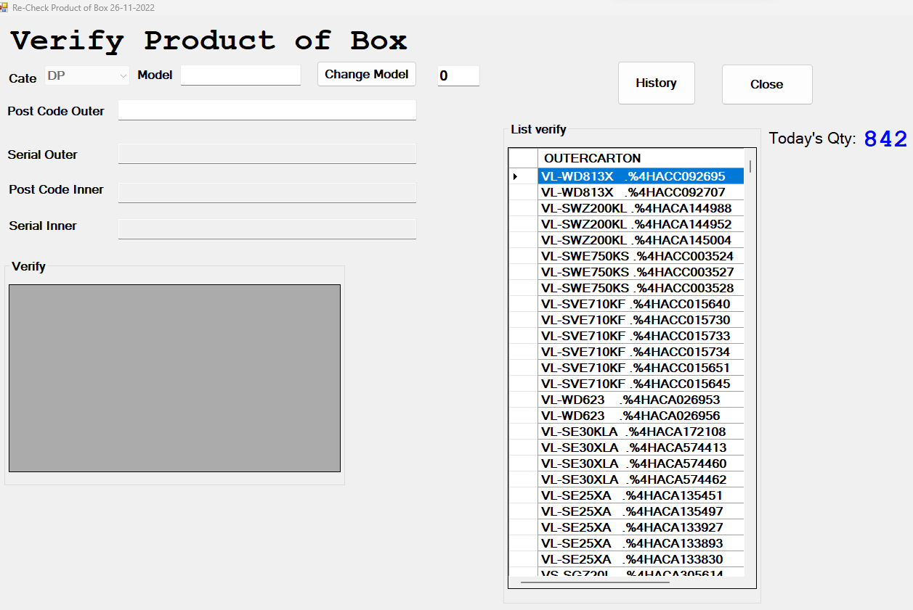



Link Weight Check System FA-SCM-OQC
Control process sample at OQC area
Pick up sample
Reading barcode Inner/Outer excel file
Weight check 1st
OQC
inspection
Reading BC
Product/Inner excel file
Weight check 2nd
Reading barcode
Inner/Outer excel file
Return to Pallet
No Link
No Link
No Link
Reliability
No Link
No Link
No Link
No Link
Production Line
Confirm S/N Outer & all inner boxes
Accessory control
Numbering control & Separate area
Product / Warranty/ Manual & Inner box
Accessory control
Confirm S/N Outer & all inner boxes
Warehouse FA
Improvement
Get sample by Mobile
Scan barcode Inner/Outer by new software
Weight check 1st
OQC
inspection
Reading BC inspection result by new software
Weight check 2nd
Scan barcode Inner/Outer by new software
Return to Pallet by mobile
Reliability
Production Line
Confirm S/N Outer & all inner boxes
Accessory control
Numbering control & Separate area
Product / Warranty/ Manual & Inner box
Accessory control
Confirm S/N Outer & all inner boxes
Warehouse FA
Database server

Slide 2

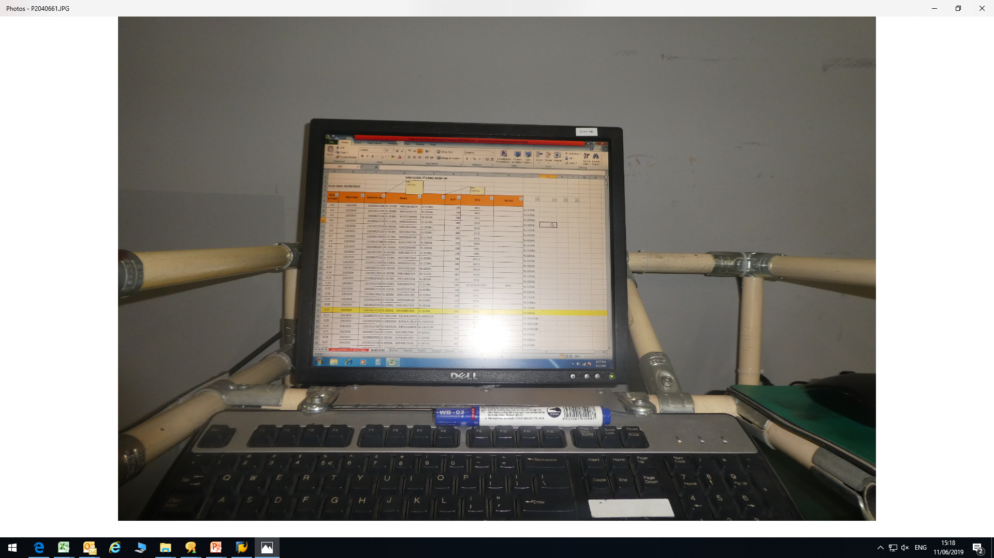

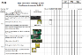
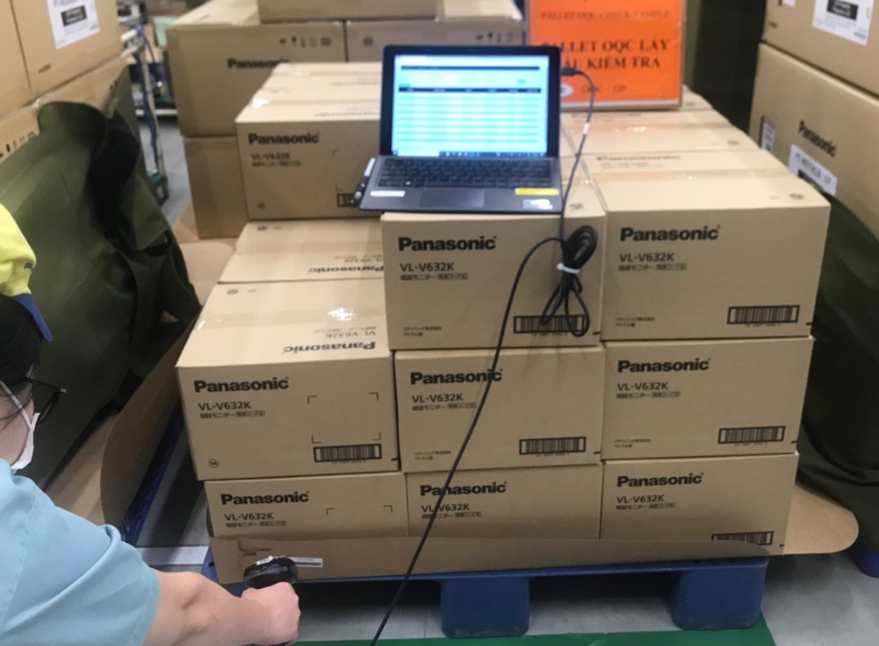


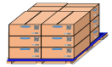


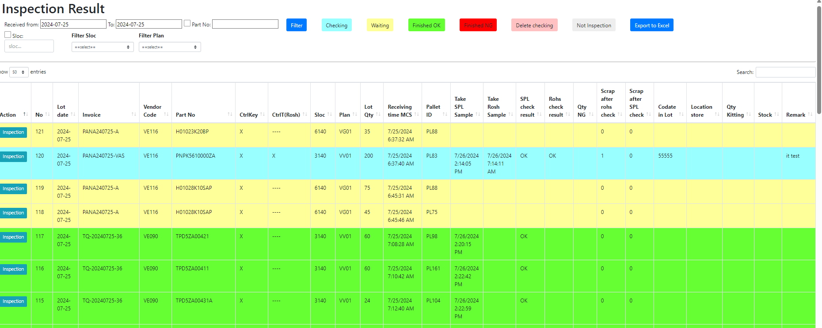
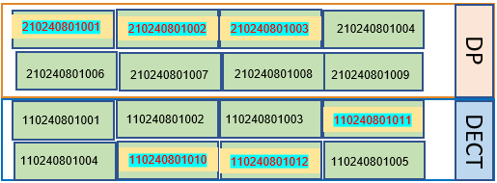



Link Weight Check System FA-SCM-OQC
E chop for OQC inspection
Line 1A
OQC Inspection
Line 2A
Weight check 1
Scan serial outer / inner the first
OQC inspection
Scan serial outer / inner the second
Weight check 2
Input inspection result on excel file
OQC inspection result
Line 3A
OK
NG
OQC member pick up sample
Chop stamp Process
Line 4A
Recode ID Pallet & S/N carton box by excel file
Find all same model, production date, line, shift
Line 5A
OQC find Pallet ID
Matching ID Pallet and Outer Carton
OQC chop stamp all ID Pallet
OK
NG
location
OQC
Database server
Production line
Day- Month- Year
New system link FA-SCM-OQC
E – chop can
replace
Auto judgment OK for
All pallet ID the same Model, production date, line and shift.
FA
Link
OQC
Link
SCM
Shrink machine
Visualize OQC inspection
OK
OQC return sample
FA shrink pallet ID
FA fix location
Day- Month- Year
OQC
DP area
DECT area
SCM Warehouse
SCM Out location
Visualize FA Warehouse area
WMS system
Shipping To market

Slide 3
Link weight check system FA-SCM-OQC
◆Before
◆ After
FA
OQC
SCM
FA
Link
OQC
Link
SCM
No indicate shipment priority
No indicate result timely
Cannot use weight system → compare S/N by manual
Update OQC result not timely.
Loss time to come to SCM for chop stamp.
Loss time to confirm stamp by visual check
Indicate result timely
Indicate shipment priority
Use weight system → auto compare S/N
Online update OQC result & Save time to come to SCM for chop stamp
No need check stamp by visual
Confirm OQC result by system
Target improve:
Prevent wrong packing leakage out to market
△ 2pax for stamp by manual
2pax
OQC Issue
Risky point : Wrong packing pass to market by control offline
Loss time to confirm production result & Shipment schedule : 90sec*150 lots=3.75H/day.
2pax/ day need to follow chop stamp in warehouse.
Improvement: Link system from FA-OQC-SCM
Prevent wrong packing.
Save time : 3.75H/day ~ 990H/year
Save manpower : △ 2pax for stamp ~ 12K$/ year

Slide 4
Link weight check system FA-SCM-OQC
Make Planning
SCM
Send file production plan
FA
Compare Stock base on file plan and send file
OQC
Pick up sample to Inspection
Send file production plan

